Slide 1

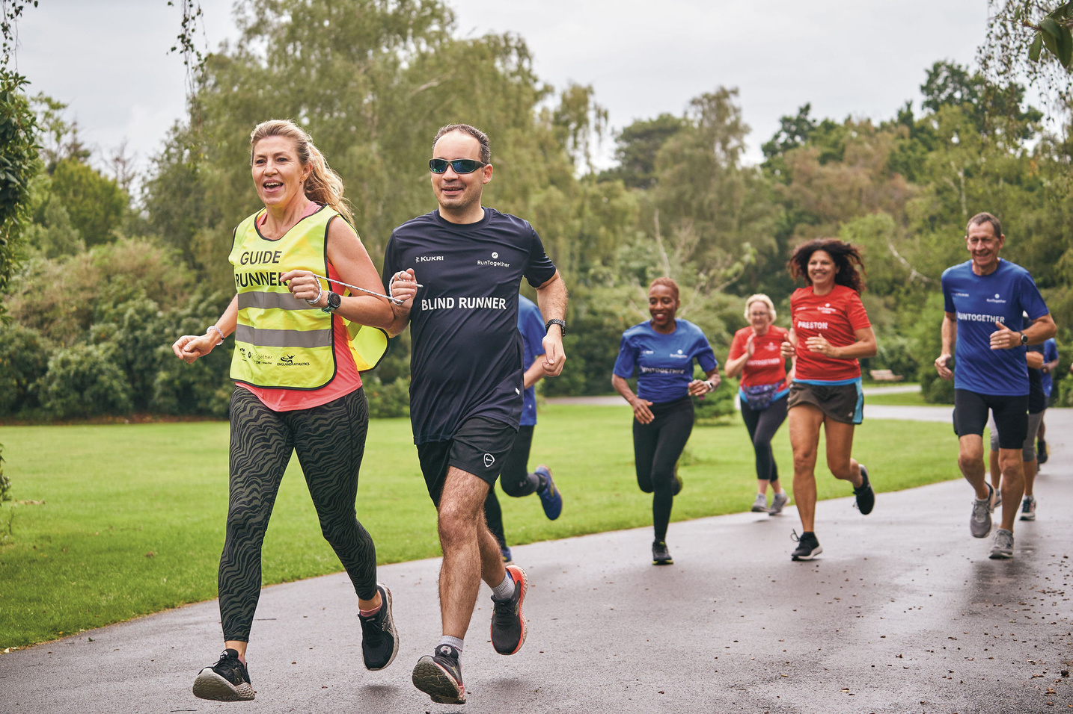
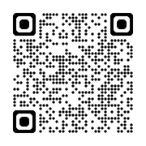
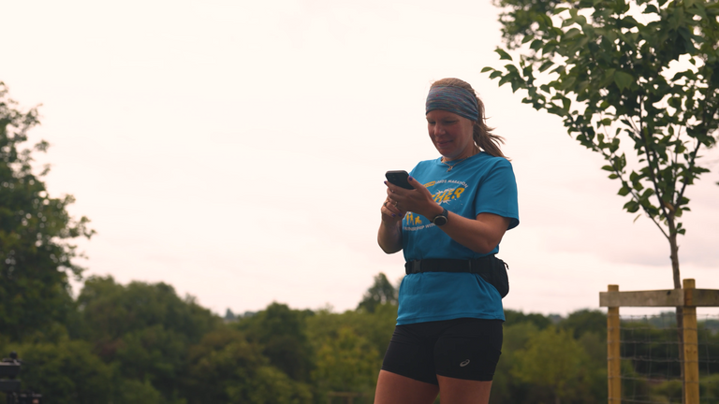
Register to join the fun: www.runtogether.co.uk
Helping people to
run together
in your community
RunTogether is all about community, friendships and the opportunity to experience running in a way that interests you. We have:
Runners
Run Leaders
Run Leader Mentors
Mental Health Champions
Guide Runners
Find the group for you: www.runtogether.co.uk
SAVE BIG ON THE BRANDS YOU LOVE, JOIN RUN:EA TODAY.

